Slide 1
Cluster Analysis
Nominal Level Variable Clustering:
K Modes Clustering

Slide 2
What is the objective of k means?
k means clustering required variables to be at least interval in nature, thus the mean had real meaning for these variables and could be used in the clustering algorithm
But what about clustering variables that are nominal in nature? How does that work?
There is a method called k modes clustering that uses the mode to help define distances and establish clusters*
*Huang, Z. (1997). “A Fast Clustering Algorithm to Cluster Very Large Categorical Data Sets in Data Mining.” In Proceedings of the SIGMOD Workshop on Research Issues on Data Mining and Knowledge Discovery, 1–8. New York: ACM Press.

Slide 3
What is the objective of k means?
One of the most obvious issues is that of distance
In k means we had a bunch of potential distance measures – Euclidean, Manhatten, Mahalanobis…
But what about clustering variables that are nominal in nature? How does that work?
K modes uses a dissimilarity metric to help establish distances
*Huang, Z. (1997). “A Fast Clustering Algorithm to Cluster Very Large Categorical Data Sets in Data Mining.” In Proceedings of the SIGMOD Workshop on Research Issues on Data Mining and Knowledge Discovery, 1–8. New York: ACM Press.

Slide 4
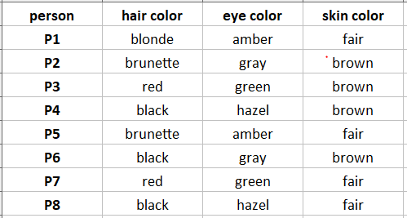
How does k modes work?
Let’s assume that we have three nominal level variables - hair color, eye color and skin color
And we decide – just like k means – that there will be three clusters e.g. k=3
https://www.analyticsvidhya.com/blog/2021/06/kmodes-clustering-algorithm-for-categorical-data/

Slide 5
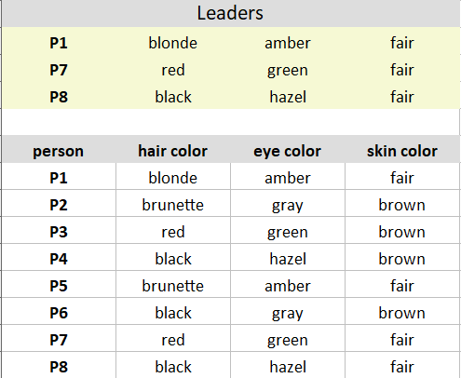
How does k modes work?
Pick three observations at random that will be become the kernels or “leaders” of the three clusters
https://www.analyticsvidhya.com/blog/2021/06/kmodes-clustering-algorithm-for-categorical-data/

Slide 6
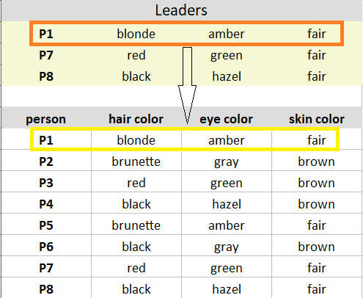
How does k modes work?
Compare the first leader to the first observation that is P1 leader to P1. How many dissimilarities are there? There are no dissimilarities e.g. d=0.
https://www.analyticsvidhya.com/blog/2021/06/kmodes-clustering-algorithm-for-categorical-data/

Slide 7
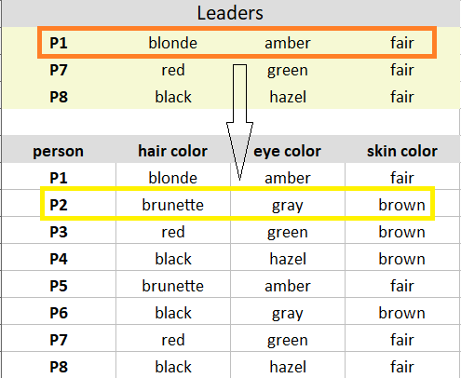
How does k modes work?
Compare the first leader to the first observation that is P1 leader to P2. How many dissimilarities are there? There are 1 (hair) + 1 (eye) + 1 (skin) = 3 = d.
https://www.analyticsvidhya.com/blog/2021/06/kmodes-clustering-algorithm-for-categorical-data/

Slide 8
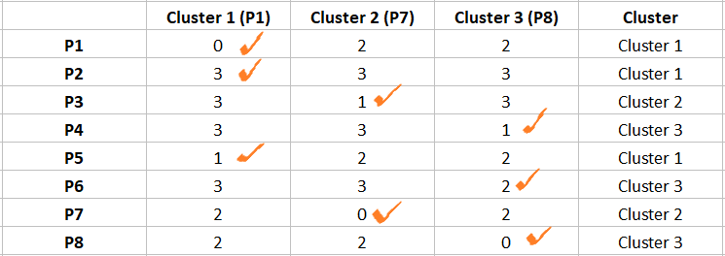
How does k modes work?
Here is the dissimilarity matrix. Note that the cells contain the number of dissimilarities for each cluster. The result is that all the observations get assigned to a cluster by noting which of the three clusters (cluster 1, 2 or 3) has the least dissimilarities. Ties mean that observation gets randomly assigned to a cluster.
https://www.analyticsvidhya.com/blog/2021/06/kmodes-clustering-algorithm-for-categorical-data/

Slide 9
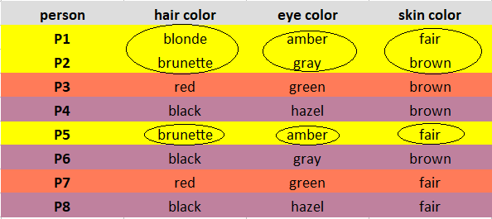
How does k modes work?
Once the observations are all assigned, here is what we have.
Cluster 1 = Yellow
Cluster 2 = Red
Cluster 3 = Purple
https://www.analyticsvidhya.com/blog/2021/06/kmodes-clustering-algorithm-for-categorical-data/

Slide 10
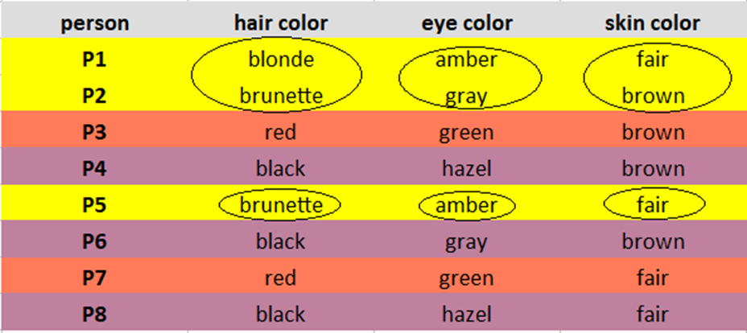
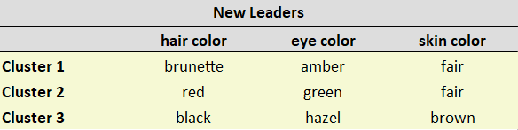
How does k modes work?
The new leaders for round 2 are outlined below. As in cluster 2 skin color, if there is no true mode then the mode is picked randomly. In this case fair was chosen as skin mode for cluster 2.
https://www.analyticsvidhya.com/blog/2021/06/kmodes-clustering-algorithm-for-categorical-data/

Slide 11

How does k modes work?
Repeat the process until no observation changes cluster identify. Then you are done!
https://www.analyticsvidhya.com/blog/2021/06/kmodes-clustering-algorithm-for-categorical-data/

